Slide 1
Amazing the End User with JavaScript
Vjekoslav Babić
MVP, Microsoft Dynamics NAV

Slide 3
C/AL
JavaScript

Slide 4
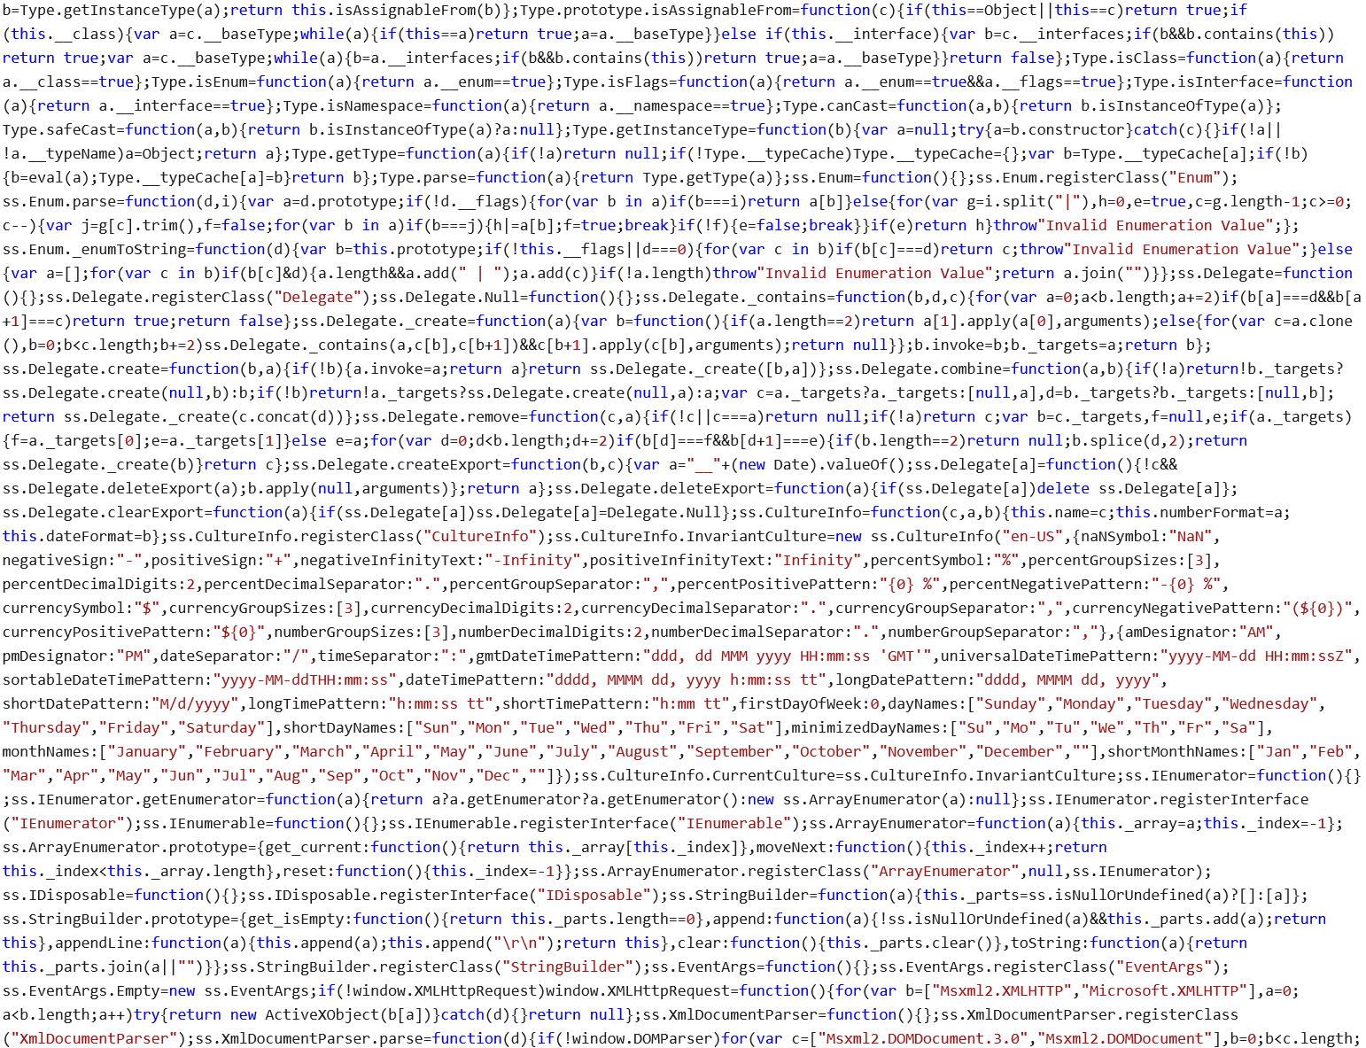

Slide 8
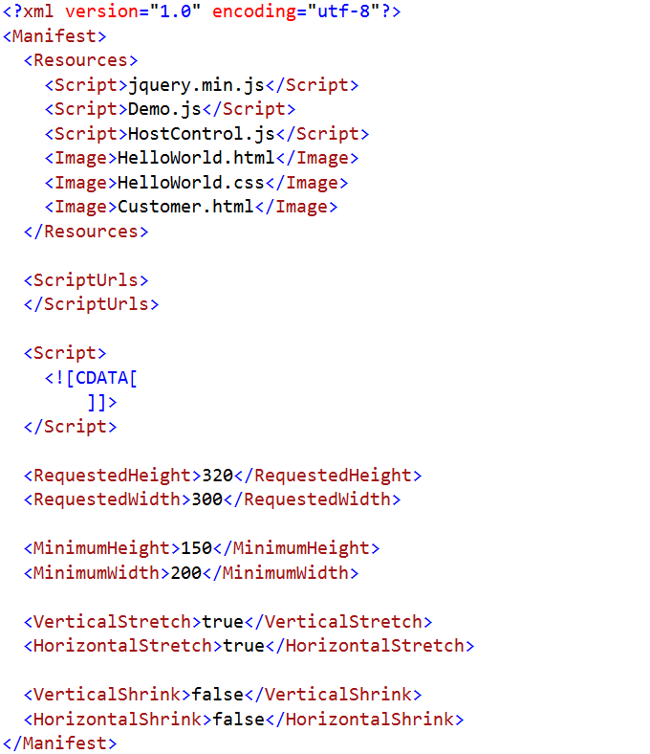
Manifest.xml

Slide 9
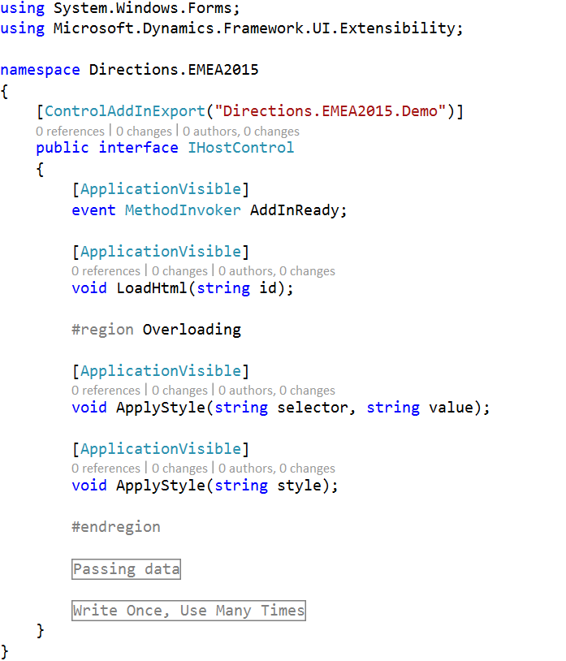
Interface

Slide 10
Deployment
Figure out the public key token
Create the Control Add-in record in NAV
Copy assembly .dll file to client add-ins folder
Zip all resource files together
Import the resource file into Control Add-in record
Repeat steps 3-5 for every change you make in interface or manifest/resource

Slide 11
One Step Deployment

Slide 12
What do we need?

Slide 13
Adding HTML

Slide 14
Adding CSS
.wife { right: 100%; margin: 0; }

Slide 15
Overloading

Slide 16
Passing data

Slide 17
Asynchronous execution

Slide 18
Debugging

Slide 19
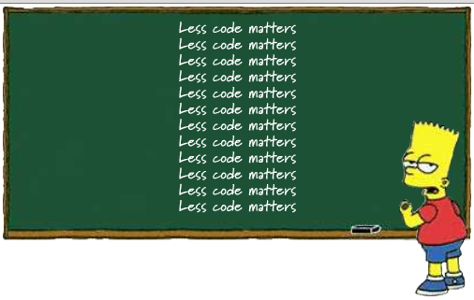
Multi-purpose Reusable Add-ins

Slide 20
Customizing .aspx files

Slide 21
Your worst enemy...

Slide 22
Thank You!

Slide 23
Join Us !

